Slide 1
Extract from session 2023 from Rafael Andrade Buono, PhD and Licenses and Reuse session from Bruna Piereck, PhD
15th June 2023, Gent
A closer look at the repositories’ world
Bruna Piereck
15th June 2023, Gent

Slide 2
Do we know why?
Why submit data?
Why should we be aware of the repositories?

Slide 3

A (somewhat) simple start
Alice is a researcher who:
Works with plants
Is generating whole genome sequencing data
Makes use of several public platforms for tools and data
Has the current project funded by a public funding agency
Aims at publishing work in an open and peer reviewed journal

Slide 4
A (somewhat) simple start
Alice is a researcher who:
Works with plants
Is generating whole genome sequencing data
Makes use of several public platforms for tools and data
Has the current project funded by a public funding agency
Aims at publishing work in an open and peer reviewed journal
What is written in the DMP?

Slide 5
A (somewhat) simple start
Alice is a researcher who:
Works with plants
Is generating whole genome sequencing data
Makes use of several public platforms for tools and data
Has the current project funded by a public funding agency
Aims at publishing work in an open and peer reviewed journal
What is written in the DMP?
Are you cleared for depositing?
Ethical and legal issues
Data availability requirements of the funder and of the journal

Slide 6
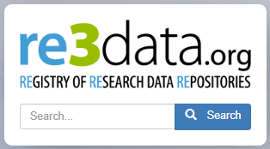

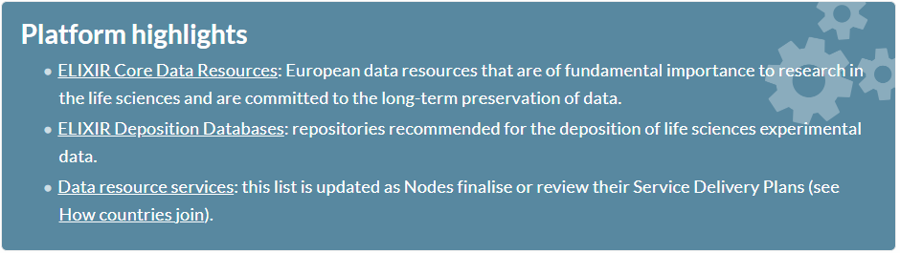
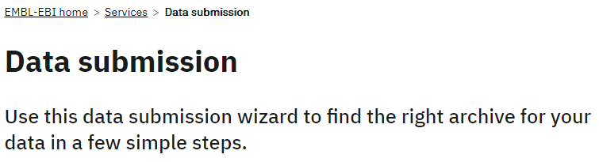
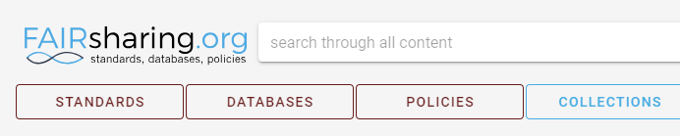

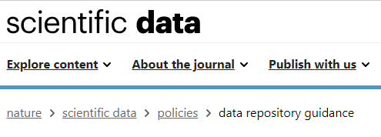

How to find a repository?
https://www.re3data.org/
https://elixir-europe.org/platforms/data
https://fairsharing.org/
https://www.ebi.ac.uk/submission/
Hey, Jim!
Where am I supposed to deposit this data?
Deposit?
I usually just ship a usb drive upon request!
https://www.nature.com/sdata/policies/repositories

Slide 7
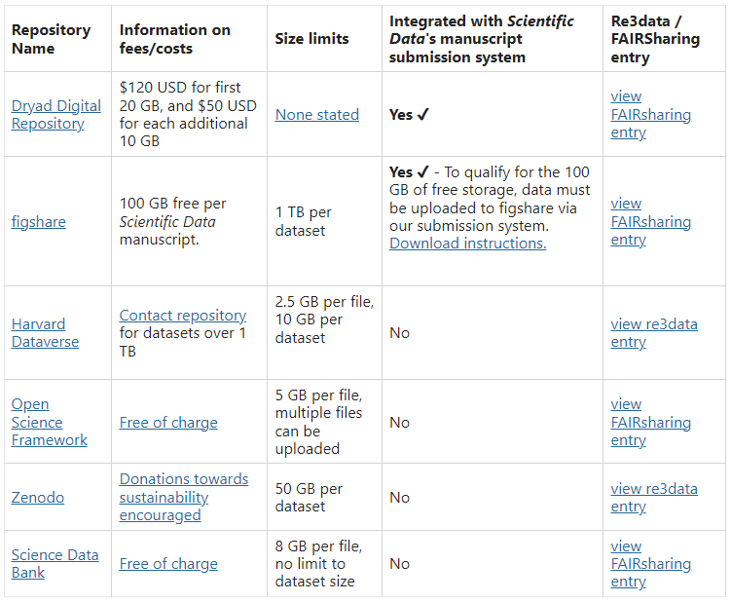
Generic vs. Domain specific
There are a few generalist repositories out there
Your institution might have a data repository that fulfils requirements from funders and journals
They might still not match your data type
Where do you find data?
Which repository can best connect you with the broader community?
https://www.nature.com/sdata/policies/repositories

Slide 8


Let's find a repository
Alice is a researcher who:
Works with plants
Is generating whole genome sequencing data
Makes use of several public platforms for tools and data
Has the current project funded by a public funding agency
Aims at publishing work in an open and peer reviewed journal
https://www.re3data.org/
https://fairsharing.org/
Identify a couple of potential repositories using re3data and FAIRsharing
Domain specific
Justify the choice
What information can you find about the repository that might help you?

Slide 9
Other ways to find a repository
https://elixir-europe.org/platforms/data
Focus on Life Sciences

Slide 10
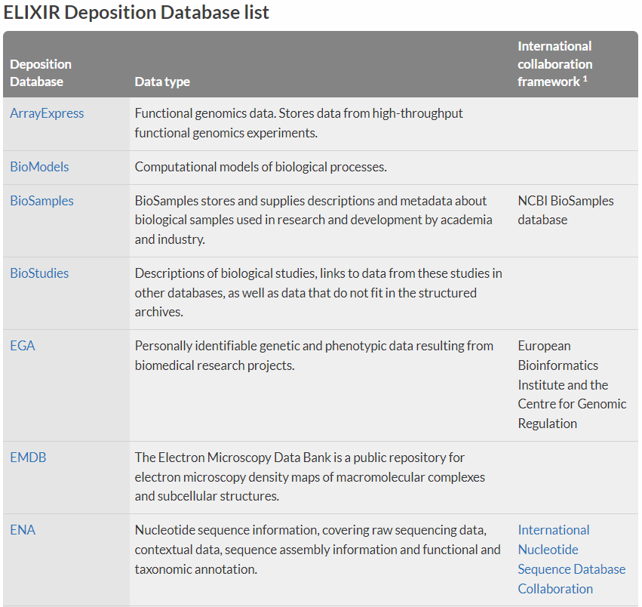
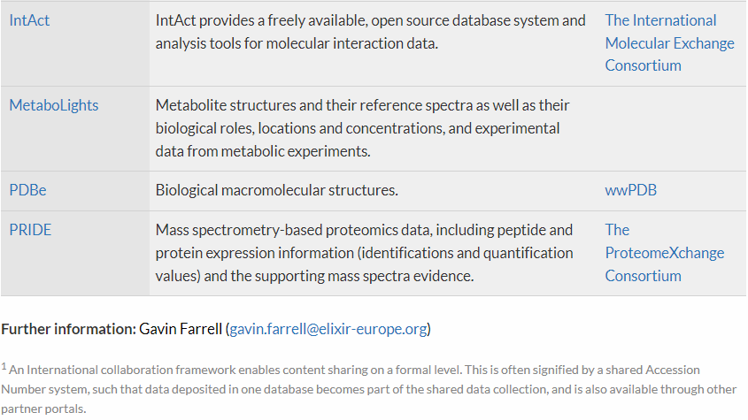
The ELIXIR recommended deposition databases
https://elixir-europe.org/platforms/data/elixir-deposition-databases
Focus on experimental data

Slide 11
Why is it a good idea to deposit your data?

Slide 12
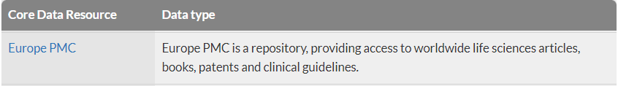
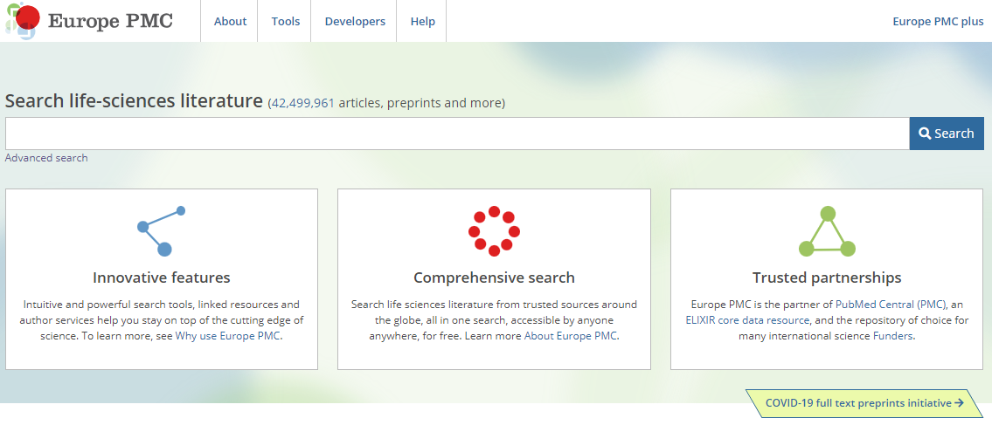
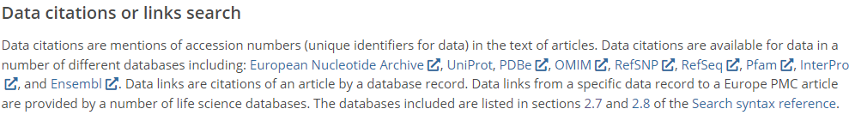
A short side note on visibility
Why is it a good idea to deposit your data?
https://europepmc.org/Help#searchdata

Slide 13
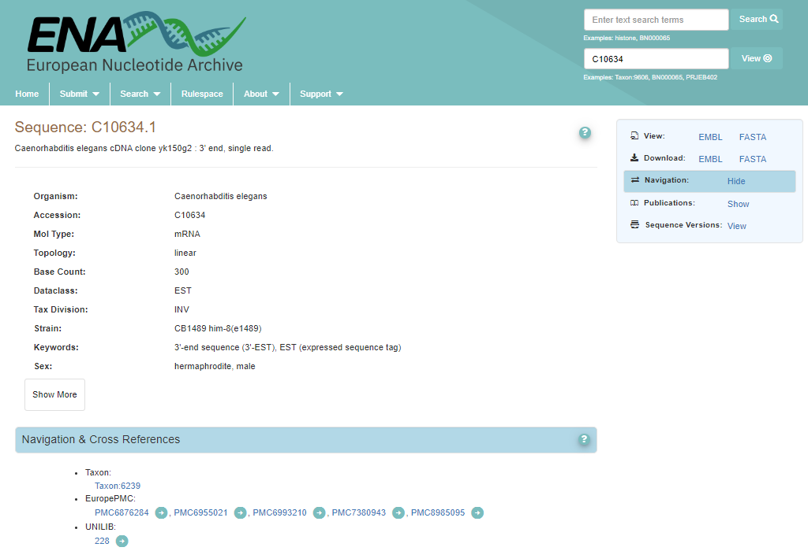
Cross referencing resources
Why is it a good idea to deposit your data?

Slide 14
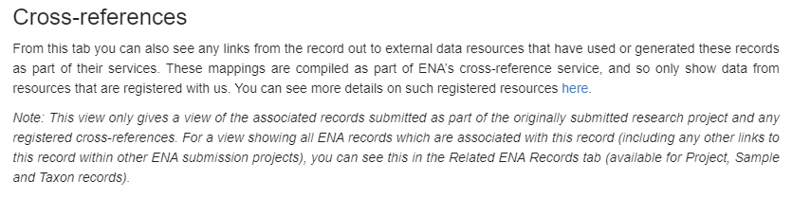
Cross referencing resources
Why is it a good idea to deposit your data?

Slide 15
Many ways to find
How do I know which data goes where?
When should I consider it?

Slide 16
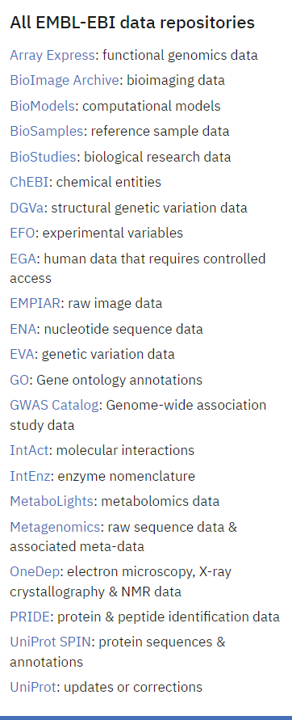
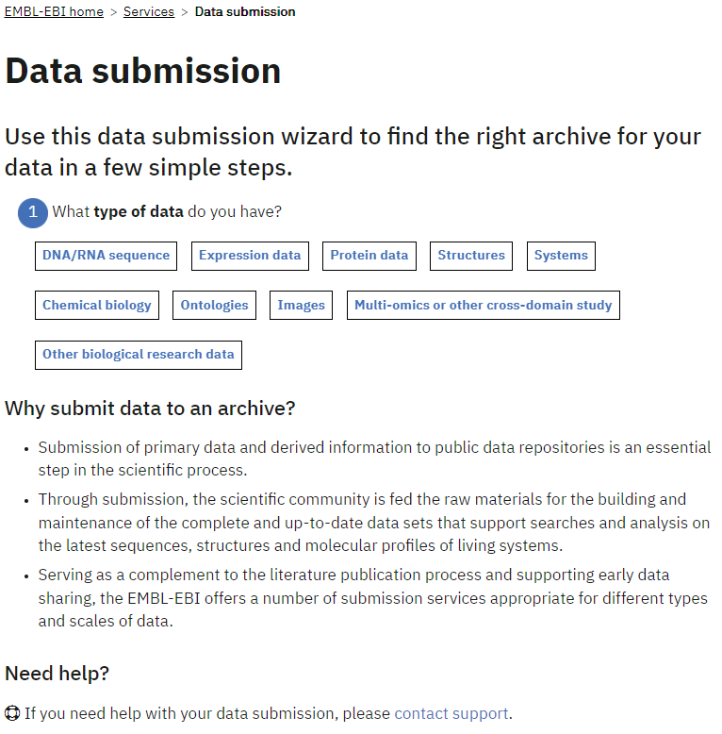
A wizard can be of help
https://www.ebi.ac.uk/submission/

Slide 17
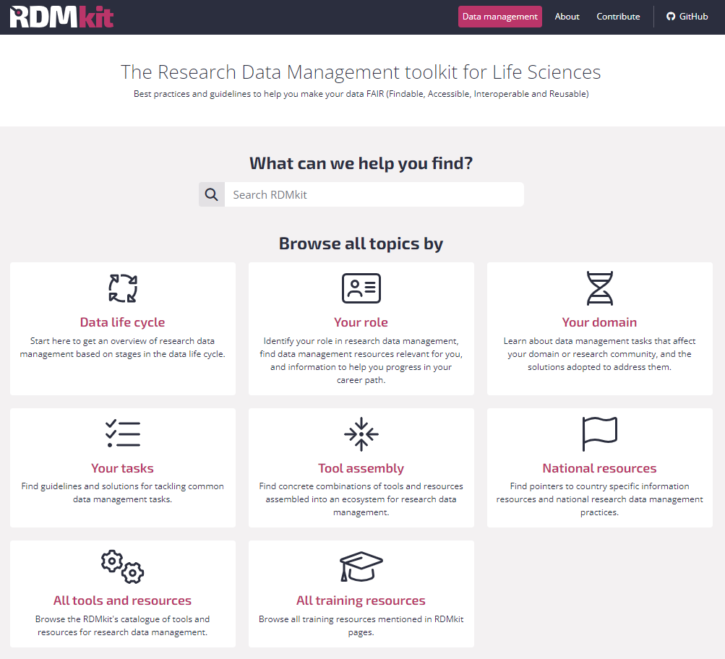
Other ways to find a repository
Community driven content
https://rdmkit.elixir-europe.org

Slide 18
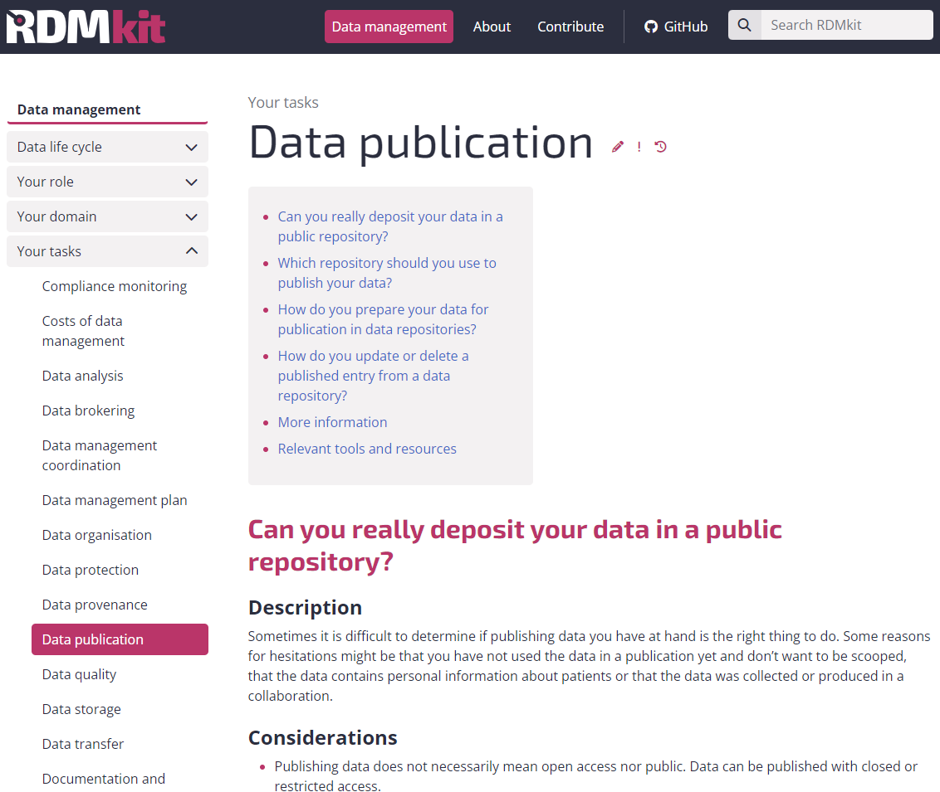
Other ways to find a repository
https://rdmkit.elixir-europe.org/data_publication

Slide 19
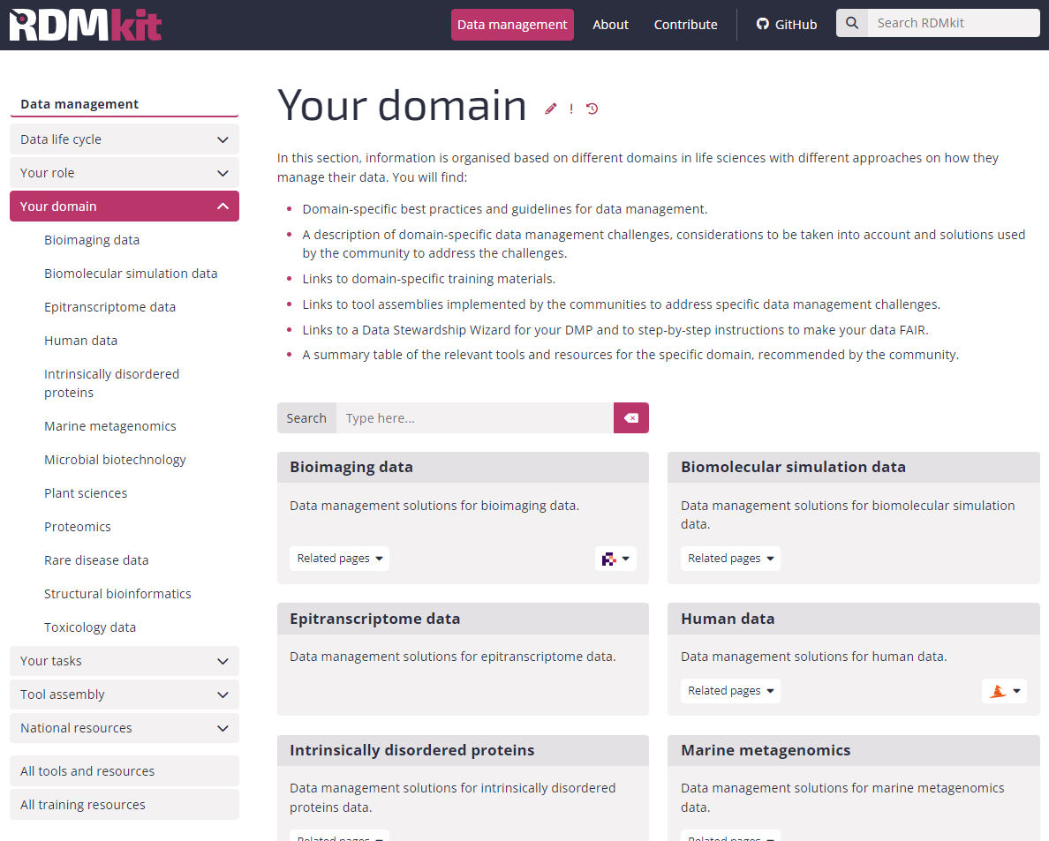
Other ways to find a repository
Are there recommendations for the domain?
https://rdmkit.elixir-europe.org

Slide 20
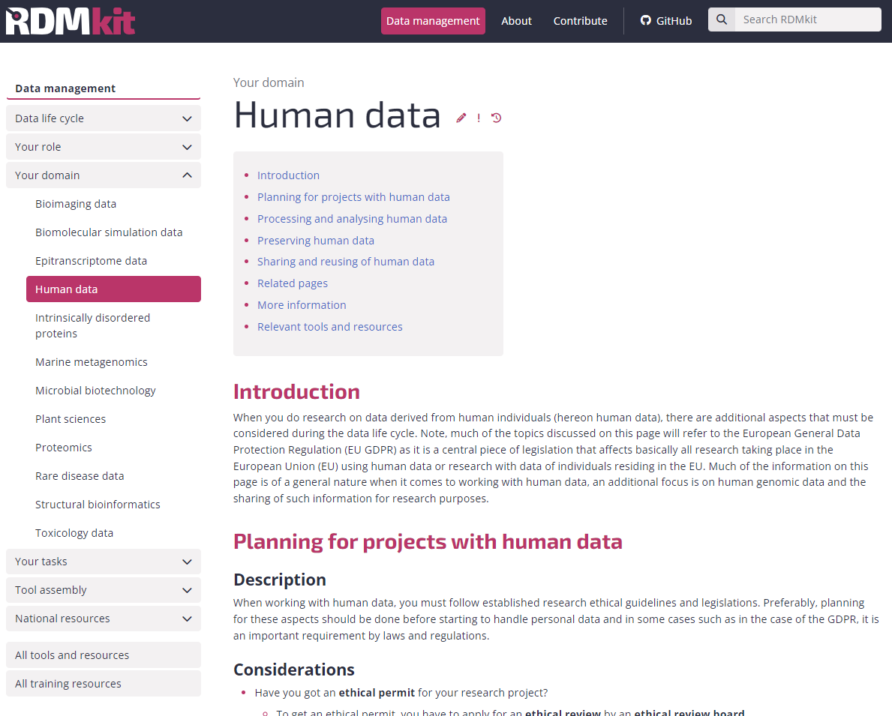
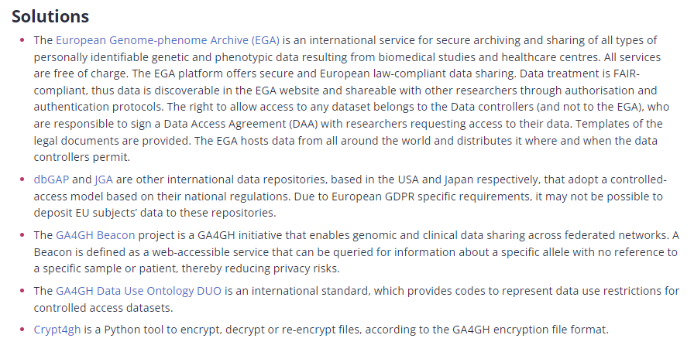
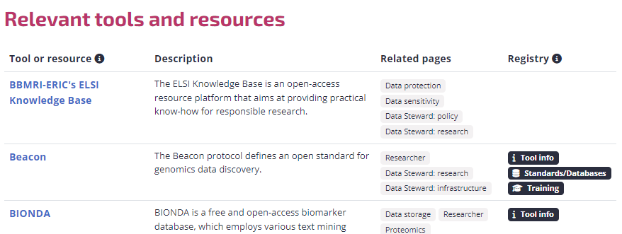
Other ways to find a repository
https://rdmkit.elixir-europe.org/human_data

Slide 21
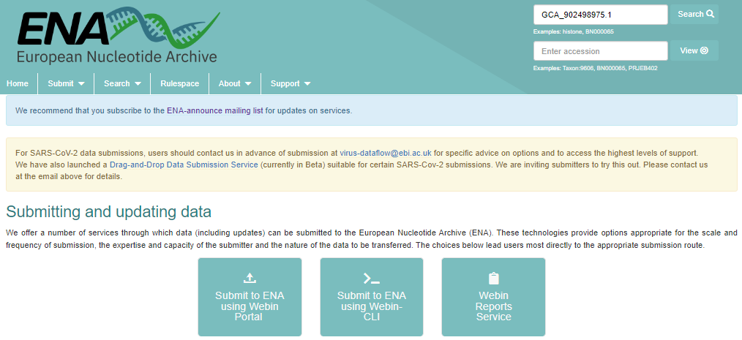
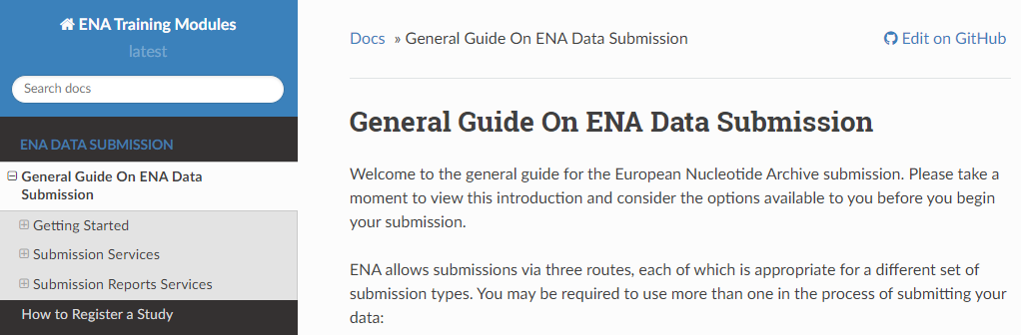
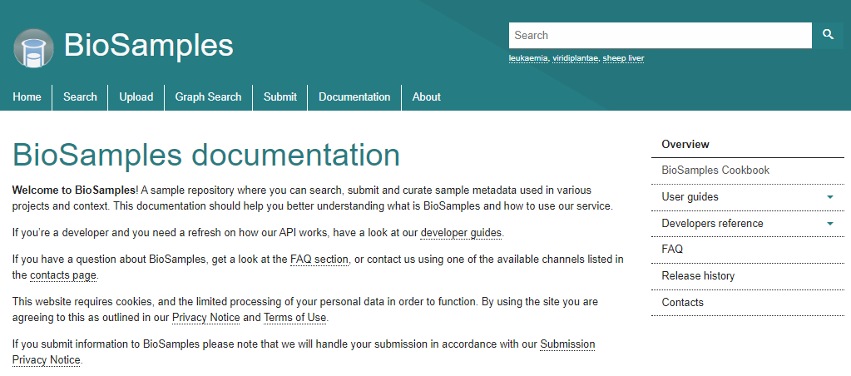
Data submission
Different repositories = different routes
What file formats are expected?
What metadata is expected?
Can ontologies and controlled vocabularies be used?
Are there costs involved?
Is there a license to be applied? Is it implicit?
https://www.ebi.ac.uk/ena/browser/submit
https://ena-docs.readthedocs.io/en/latest/submit/general-guide.html
https://www.ebi.ac.uk/biosamples/docs

Slide 22

Let's find a repository
Alice is a researcher who:
Works with plants
Is generating whole genome sequencing data
Makes use of several public platforms for tools and data
Has the current project funded by a public funding agency
Aims at publishing work in an open and peer reviewed journal
https://rdmkit.elixir-europe.org
Identify a repository based on information from RDMkit
Domain specific
Justify the choice
Bonus: can you find further resources that can help you?

Slide 23
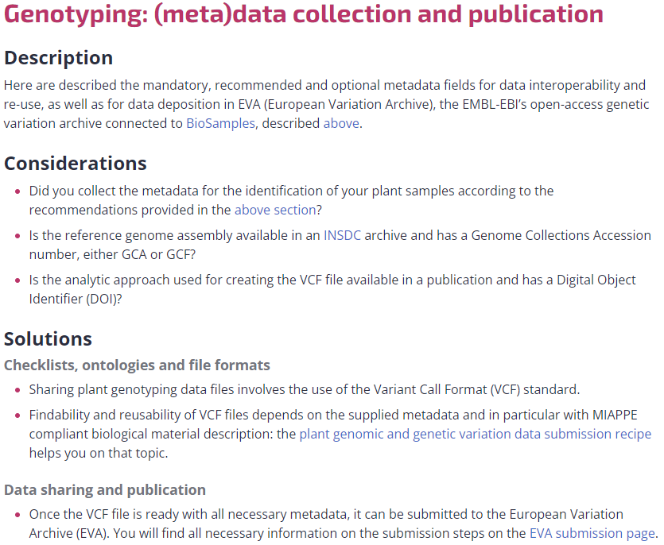
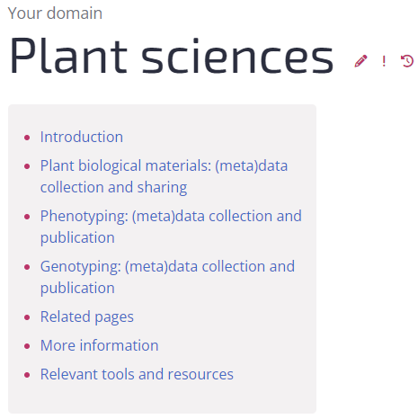
Other ways to find a repository
https://rdmkit.elixir-europe.org/plant_sciences

Slide 24
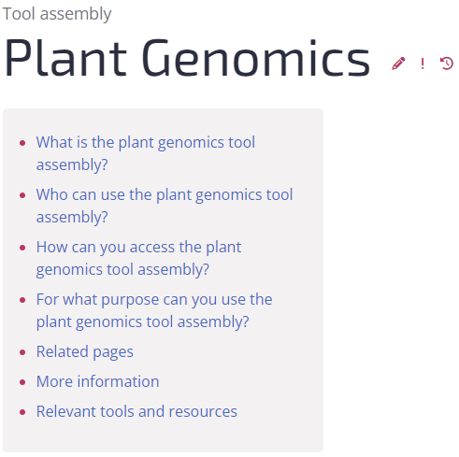
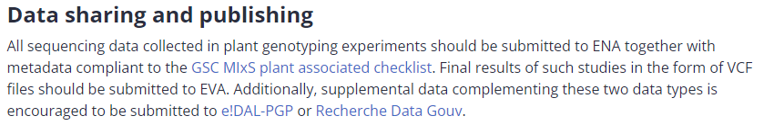
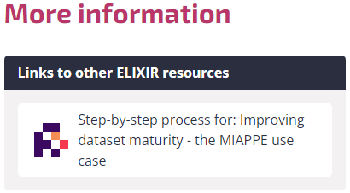
Other ways to find a repository
https://rdmkit.elixir-europe.org/plant_genomics_assembly

Slide 25
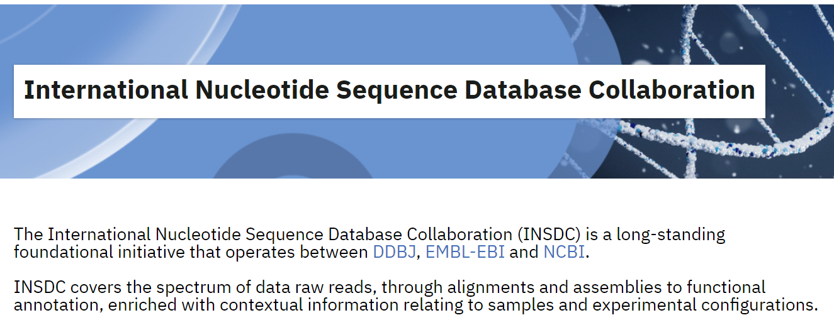
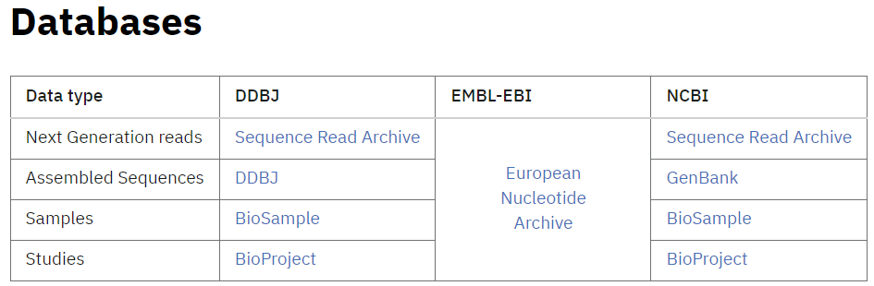
Multiple repositories with a similar data type
https://www.insdc.org/

Slide 26



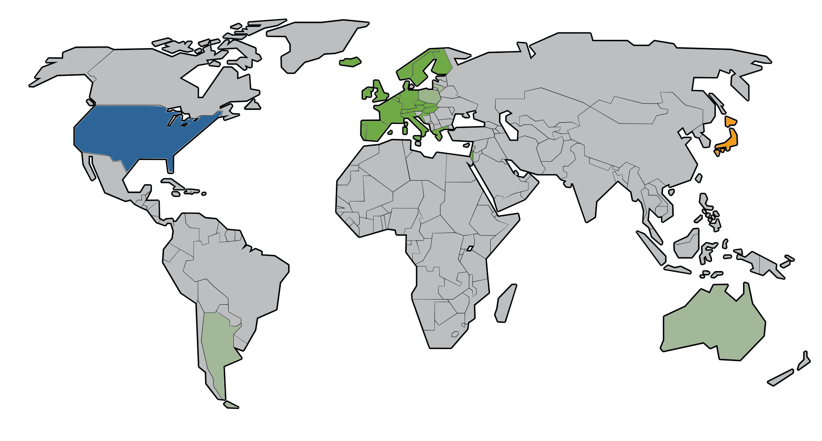


Multiple repositories with a similar data type - Genomics
2017
SRA
Thank you to Alexander Botzki for original slide material

Slide 27




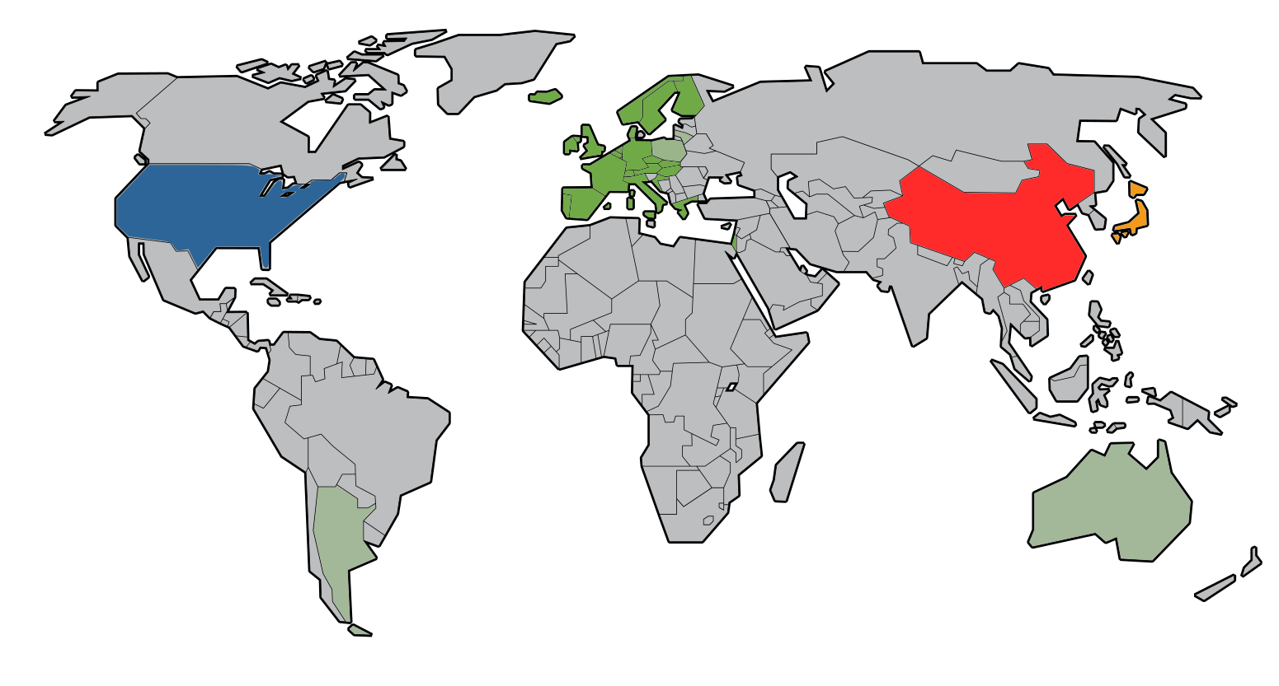





Multiple repositories with a similar data type - Proteomics
https://doi.org/10.1093/nar/gkz984
Thank you to Alexander Botzki for original slide material

Slide 28
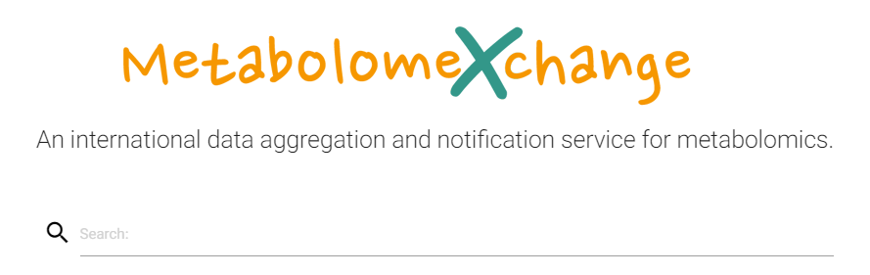
Multiple repositories with a similar data type - Metabolomics
http://www.metabolomexchange.org/
Similar initiatives are being built

Slide 29
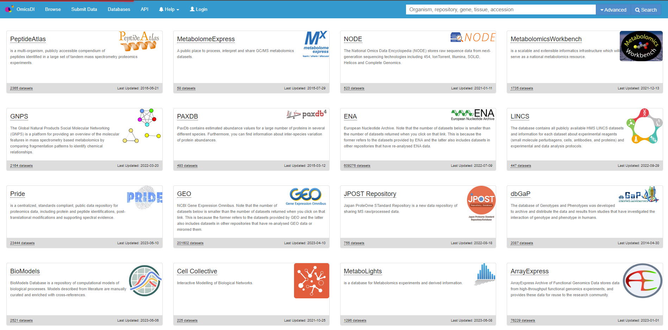
Multiple repositories with a similar data type - multi-omics
The Omics Discovery Index - OmicsDI
25 Resources
>3M Datasets
4 Continents
https://www.omicsdi.org/

Slide 30
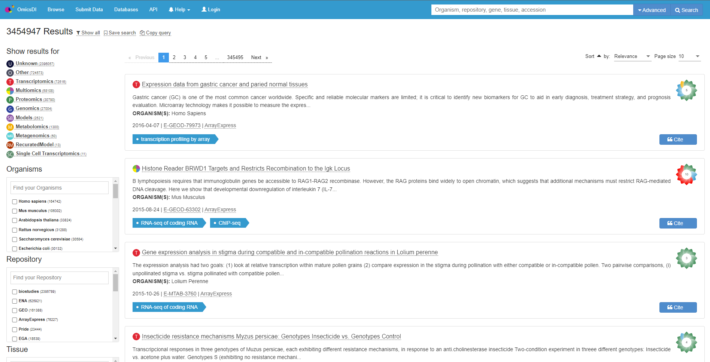
Multiple repositories with a similar data type - multi-omics
The Omics Discovery Index - OmicsDI
Indexing metadata
The richer the metadata, the easier it is to find a dataset
https://www.omicsdi.org/

Slide 31
A multi-omics project
Alice is a researcher who:
Works with plants
Is generating whole genome sequencing data
Makes use of several public platforms for tools and data
Has the current project funded by a public funding agency
Aims at publishing work in an open and peer reviewed journal
Is also generating proteomics data
Is also generating metabolomics data
Would really like that the datasets are recognized as belonging to the same project
Identify
Suitable, domain specific, repositories
A strategy (repository) to help connect the datasets

Slide 32



Multi-omics

Slide 33

Multi-omics

Slide 34

Multi-omics
BioSamples
BioSamples
BioSamples

Slide 35
Multi-omics
BioSamples
BioSamples
BioSamples
BioSamples

Slide 36

Multi-omics
BioSamples
BioSamples
BioSamples
BioSamples

Slide 37

What about human sensitive data?
“The European Genome-phenome Archive (EGA) is a service for permanent archiving and sharing of personally identifiable genetic, phenotypic, and clinical data generated for the purposes of biomedical research projects or in the context of research-focused healthcare systems.”
https://ega-archive.org/
Central metadata access
Secure storage of sensitive data
Data access defined, including Data Access Committees (DAC)
Different datasets may have different DACs

Slide 38


Access types
Open access: Data is shared publicly. Open-access is a rarely used access mode for the sharing of human data. To use open-access researchers need to ensure that the data needs is anonymised, which is difficult in practice.
Registered access: Data is shared with researchers, who have been vouched for by their institution and who agree to abide by data usage policies. Datasets that are shared via registered-access would typically have no restrictions besides the condition that data is to be used for research.
Controlled access: Access is reviewed and approved by a data access committee (DAC). Typically researchers who were involved in the primary collection of data will form the DAC. There can be a multitude of usage conditions, including allowed research topics, geographical regions, and recipients e.g. non-profit organisations.
Modified from https://rdmkit.elixir-europe.org/human_data#sharing-and-reusing-of-human-data

Slide 39
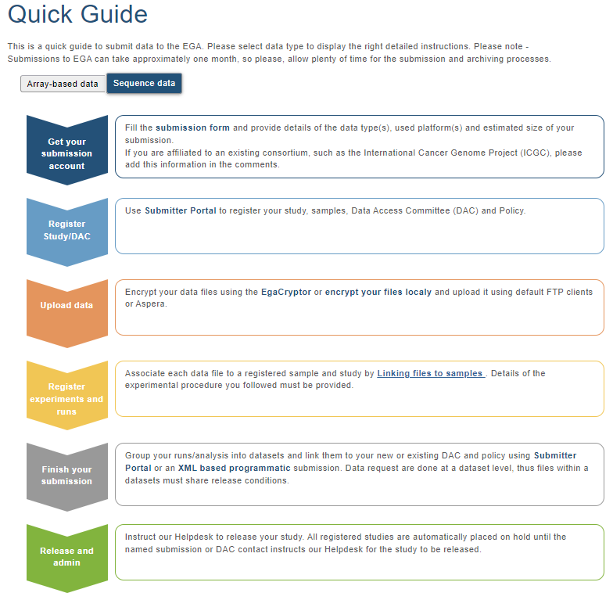
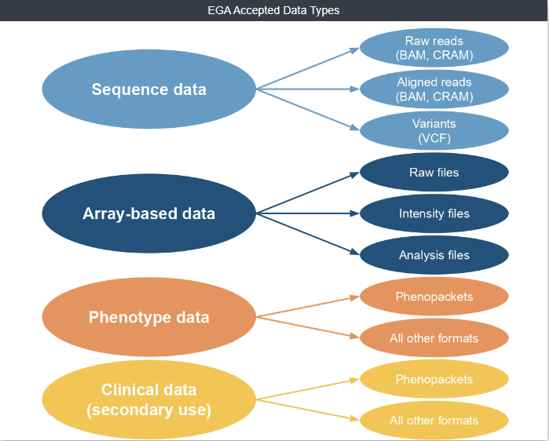
Submitting data to the EGA
https://ega-archive.org/submission
What if the data cannot leave my country?
https://ega-archive.org/submission/quickguide

Slide 40
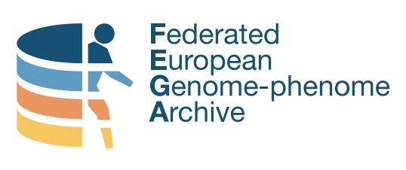
Federated EGA
“Federated EGA strives to support the discovery of and secure access to human data globally, while respecting national data protection regulations, with the goal of accelerating disease research and understanding and improving human health.”
https://doi.org/10.7490/f1000research.1118988.1
https://ega-archive.org/federated
Launched in September 2022
Data does not leave the Local EGA
Dataset discovery through the Central EGA

Slide 41

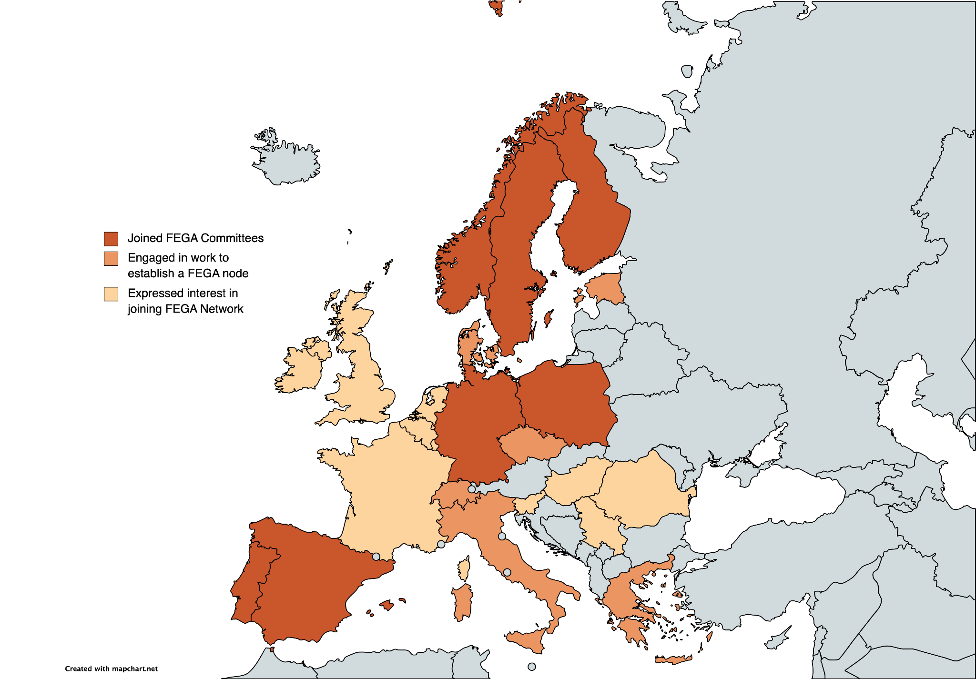
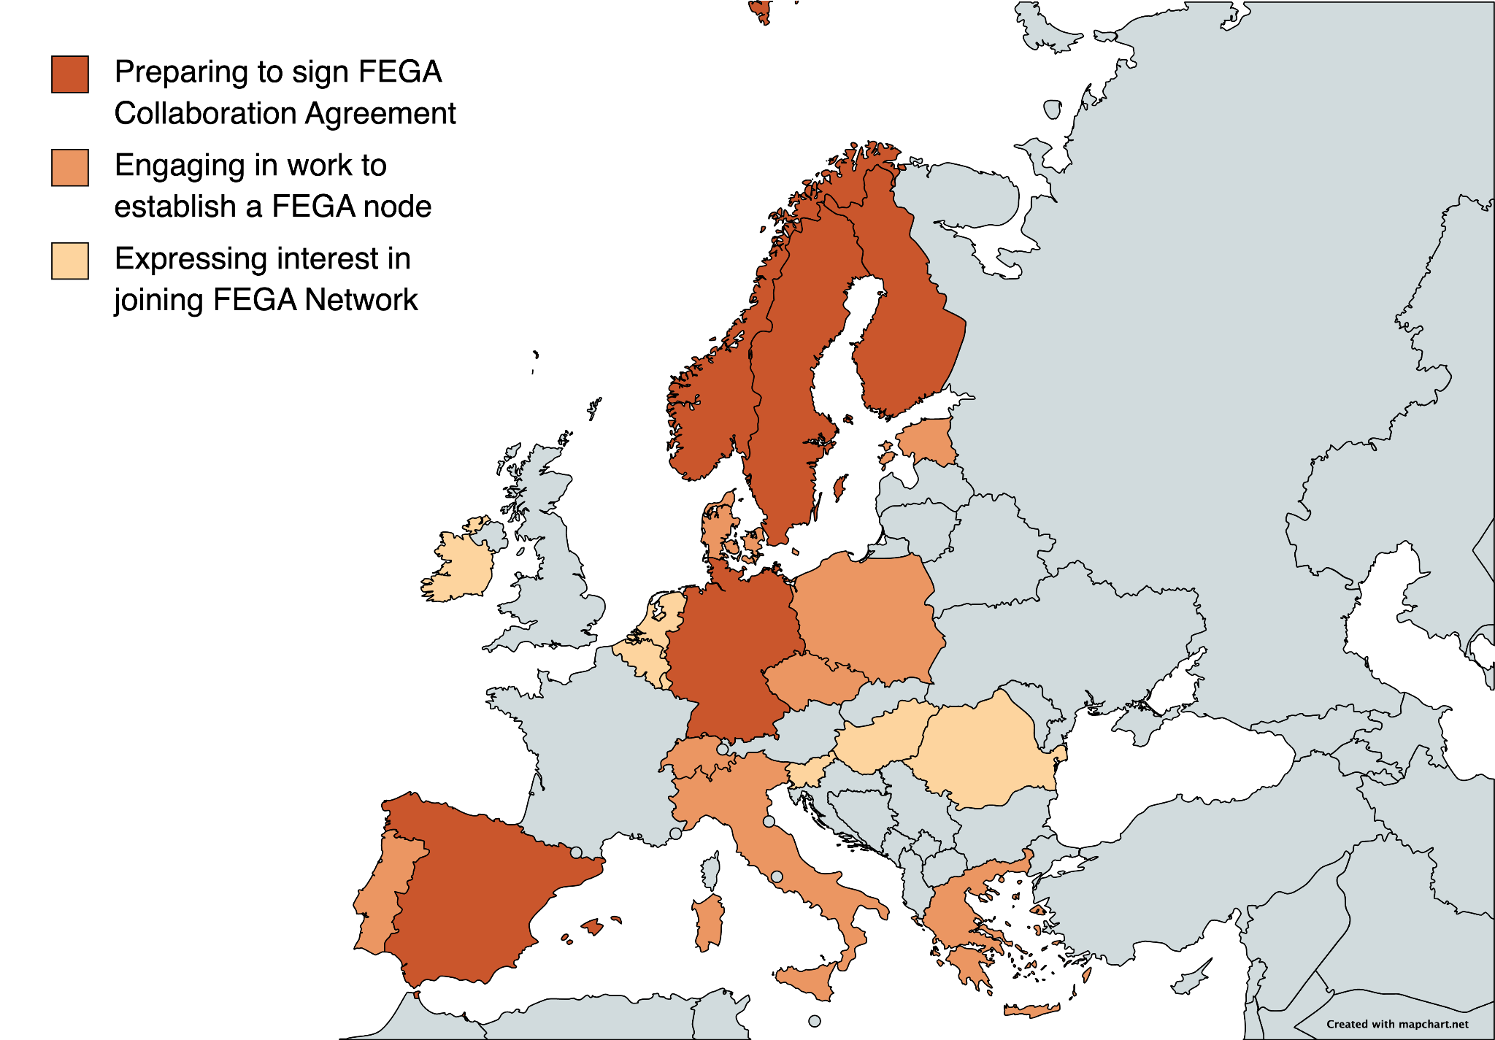
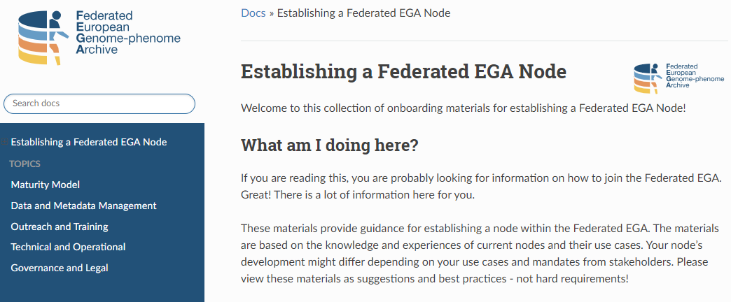
Central EGA
Federated EGA
Signed FEGA Collaboration Agreement
Joined FEGA Committees
Engaged in work to establish a FEGA node
Expressed interest in joining FEGA Network
https://ega-archive.github.io/FEGA-onboarding/
Modified from https://doi.org/10.7490/f1000research.1119478.1

Slide 42
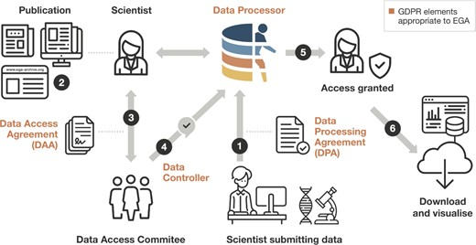
Re-using data from the EGA
Submission after a Data Processing Agreement
A scientist discovers the dataset (e.g. through a publication or by navigating the EGA)
The DAC is contacted and a DAA is defined
EGA is informed of access permission
Scientist can access the data
Data is downloaded and re-used
https://doi.org/10.1093/nar/gkab1059

Slide 43
Re-using data from repositories
Look into Licenses and Policies
For Reuse
Before depositing

Slide 44
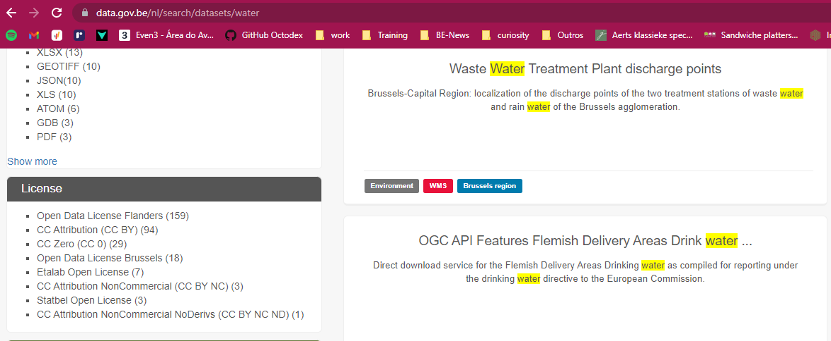
Re-using data from repositories
Look into Licenses and Policies
For Reuse
Before depositing

Slide 45
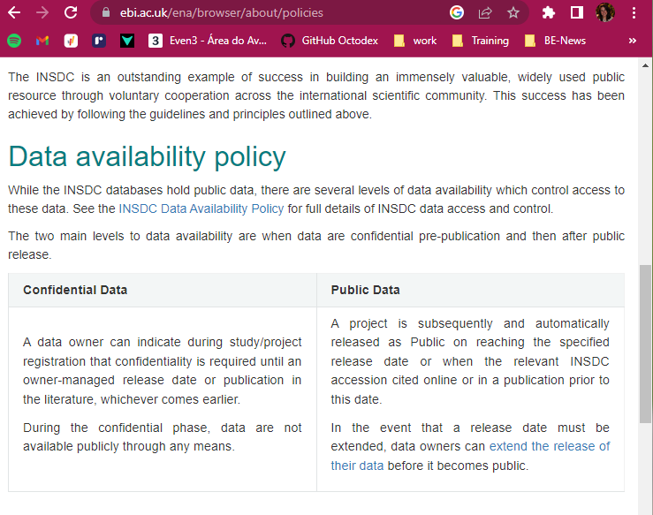
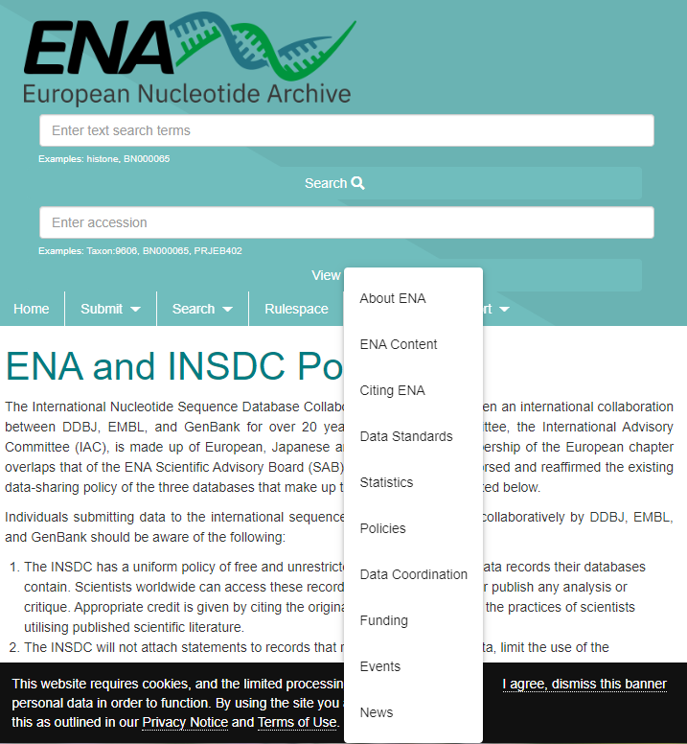
Re-using data from repositories
License/Policies
Acknowledge source
Metadata
Data quality

Slide 46
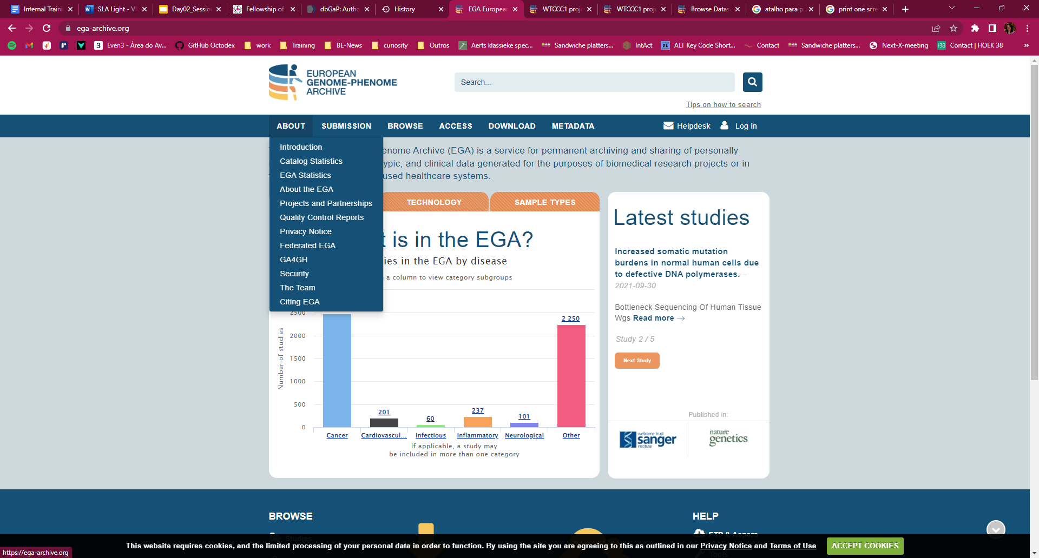
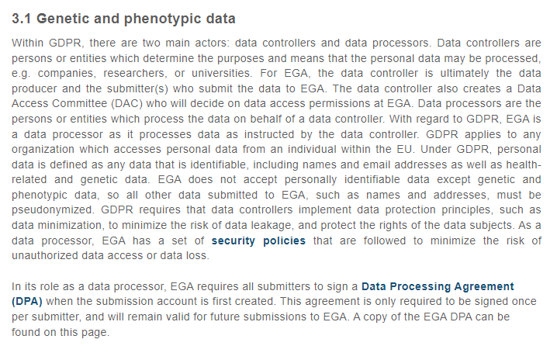
Re-using data from repositories
License/Policies
Acknowledge source
Metadata
Data quality

Slide 47





Re-using data from repositories
Look into Licenses and Policies
For Reuse
Before depositing
https://creativecommons.org/
No conditions stated! Most open.
Credit for the original creators
New creations must be shared under the same therms
Only non-commercial use
Non derivatives or adaptations are allowed, only re-use in original form

Slide 48
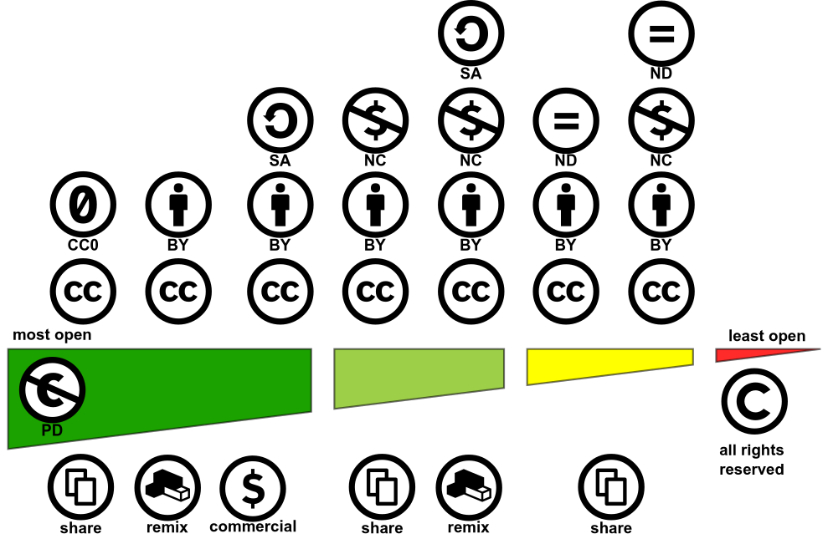

Re-using data from repositories
https://creativecommons.org/share-your-work/cclicenses/
CC-BY 4.0 Shaddim; original CC license symbols by https://creativecommons.org/
https://creativecommons.org/choose

Slide 49
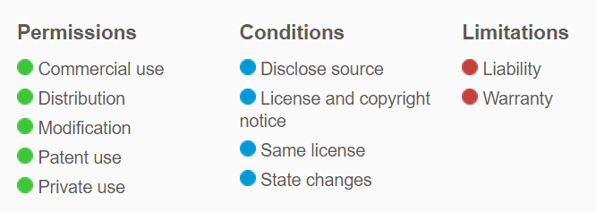

Re-using data from repositories
GNU GPLv3:
GNU AGPLv3: Complete source code modifications need to be available
GNU LGPLv3: Large modifications can be distributed under different license.
MIT license: No attribution license
Apache 2.0 ~ GNU PLv3
https://opensource.org/licenses
https://choosealicense.com/

Slide 50







A short side note on computational workflows
Where can I find workflows?
Platform/System specific repositories
The Git based repositories
Generalist data repositories
IWC - Intergalactic Workflow Commission

Slide 51

Using a registry to overcome fragmentation
Start: April 2020
Launch: Sept 2022
https://workflowhub.eu/

Slide 52


WorkflowHub
Key features
System agnostic
Native repository support
Git integration
Versioning
Links to external files (docs, test and reference data)
Metadata extraction and standards
Integration with Bio.tools
Author credit
Citable
DOI minting
A sandbox is available
https://dev.workflowhub.eu/
Modified from slide of Carole Goble at ELIXIR All Hands 2023

Slide 53


Integration with different platforms
https://usegalaxy.eu/
Connecting workflow discovery to analysis
DOI: 10.48546/workflowhub.workflow.482.3

Slide 54


info@elixir-belgium.org
https://www.elixir-belgium.org
This work is licensed under the Creative Commons Attribution 4.0 International License.
To view a copy of this license, visit http://creativecommons.org/licenses/by/4.0/

